Slide 1
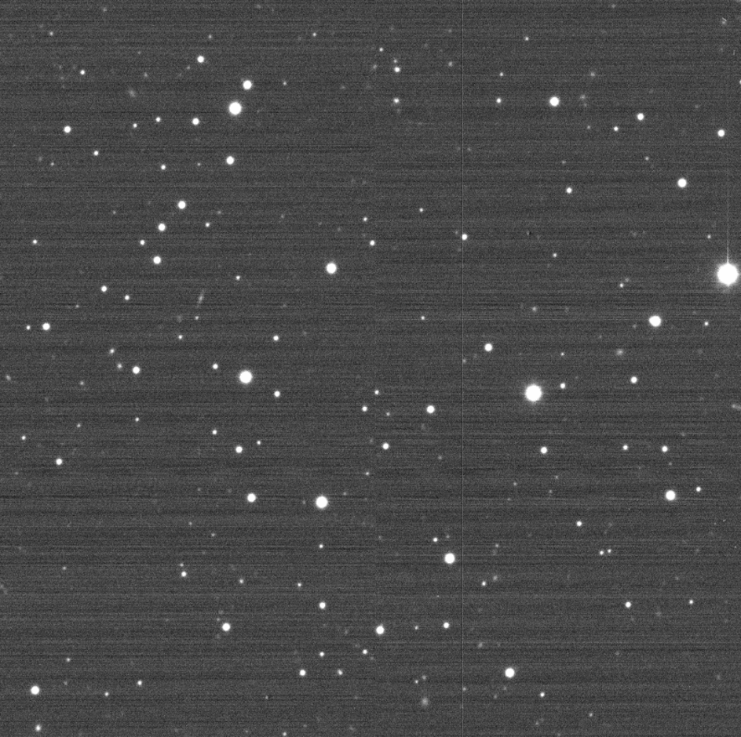
Target : 2012 TC4
Date : 2017-10-09
Time : 20:07:40 – 20:47:19 UT
Telescope : KMTNet-SAAO 1.6 m + 18K mosaic CCD
N of frames: 11 * 20 s-exposures
Filter : R-band
Solar phase angle : 32°.1516
Prepared by Dong-Heun Kim

Slide 2
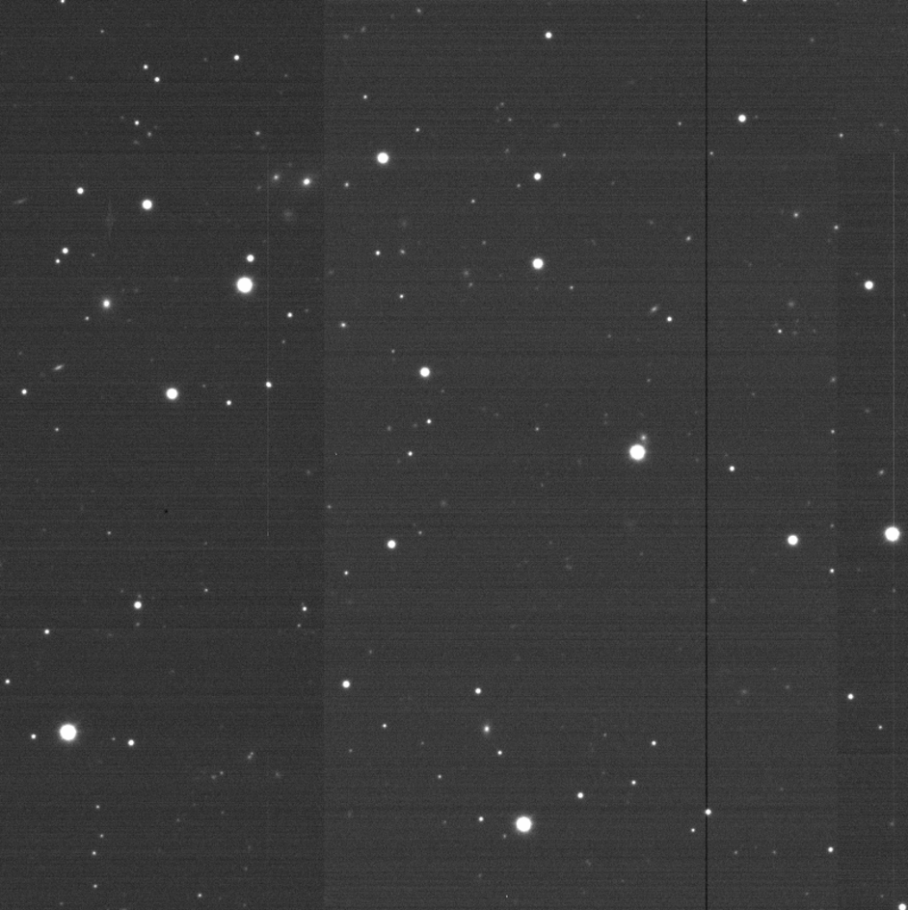
Target : 2012 TC4
Date : 2017-10-10
Time : 11:13:07 – 14:21:06 UT
Telescope : KMTNet-SSO 1.6 m + 18K mosaic CCD
N of frames: 12 * 15 s-exposures
Sequence : R-band
Solar phase angle : 33°.8334
Prepared by Dong-Heun Kim

